Slide 1
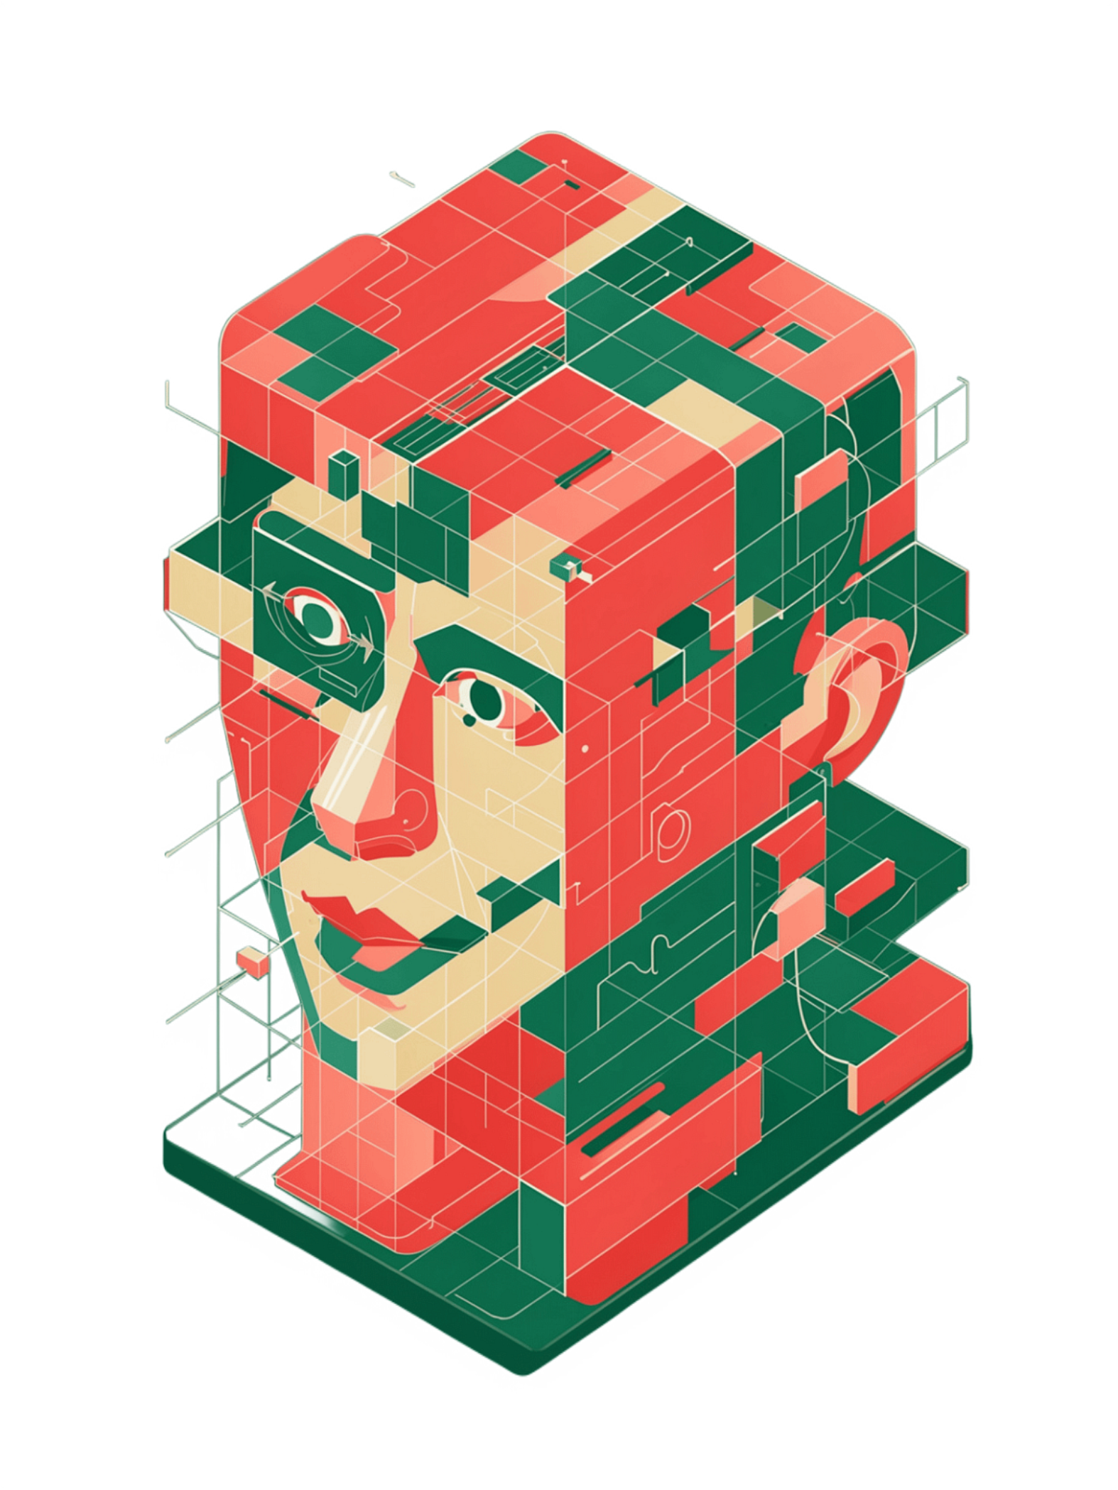
Face and Non-Face Identification Based on Facial Image Region Using Different Methods and Classifiers
Student
Supervisor
Md. Maruf Hosen
Roll: 1752
Prof. Mohammad Shoyaib

Slide 2
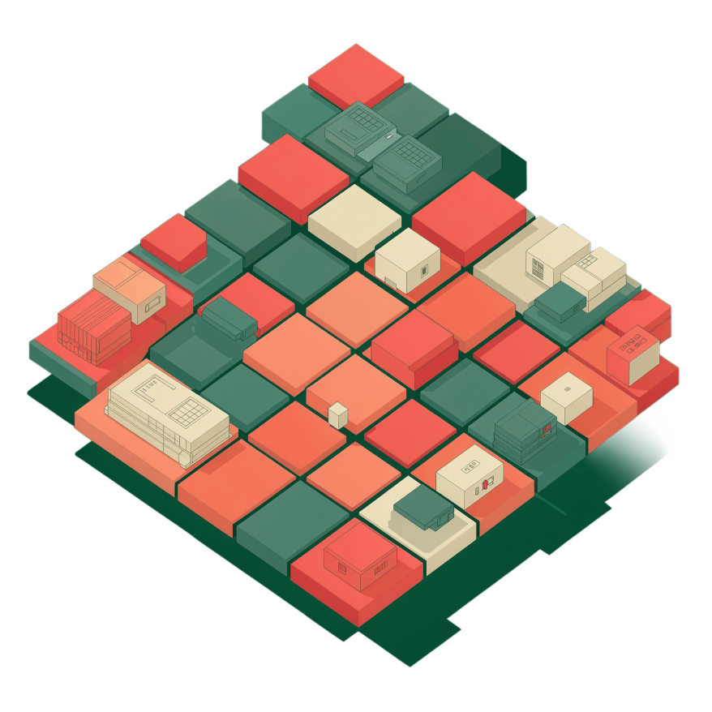
Project Description
This project focuses on Face and Non-Face Image Classification based on the part of the image using a combination of feature representation, pooling, and ensemble learning techniques.
Input images are divided into tiles and converted into feature vectors. Three pooling methods are applied to generate different feature representations:
Max Pooling — selects maximum feature values
Mean Pooling — averages feature values
Attention Pooling — weighted importance representation
Each representation is then classified using Random Forest (Information Gain and Hellinger Distance) and AdaBoost ensemble classifiers, with the performance of all combinations compared.

Slide 3


Methods and Classifiers
Image Tiling & Feature Vector
Max Pooling
Divides the input image into smaller regions (tiles), then converts each tile into a numerical representation of its visual characteristics.
Selects the maximum value from each group of feature values to capture dominant signals.
Mean Pooling
Attention Pooling
Calculates the average value of each group of feature values for a balanced representation.
Assigns different importance weights to feature values, creating a context-aware representation.
Random Forest
Information Gain
Combines multiple decision trees to classify features into Face or Non-Face, using Information Gain or Hellinger Distance as split criteria.
Measures how effectively a feature split reduces class uncertainty in a decision tree, helping Random Forest select the best splitting criteria.
Hellinger Distance
AdaBoost
Measures the difference between feature distributions and serves as an alternative tree-splitting criterion to Information Gain in Random Forest.
Sequentially combines weak classifiers by giving more importance to previously misclassified samples.

Slide 4



Output and Results
Pipeline Summary
01
Input
JPG Image → divided into Image Tiles
Image Tiles
Feature Vector Generate with Library call
Pooling(Max, Mean, Attention)
Random Forest ,Adaboost
Face or Non Face
02
Processing
Feature Vector → Max / Mean / Attention Pooling
Performance Comparison ( 9 comparison )
03
Classification
Random Forest (Information Gain / Hellinger Distance) & AdaBoost
Performance Comparison: All combinations of Pooling Methods × Classifiers= 9 comparisons are evaluated and compared to identify the optimal configuration.

